Slide 1


SQL Project on Sample Superstore
By :
Kiran S More
Data Science Trainee - Besant Technologies,
BTM Layout

Slide 2
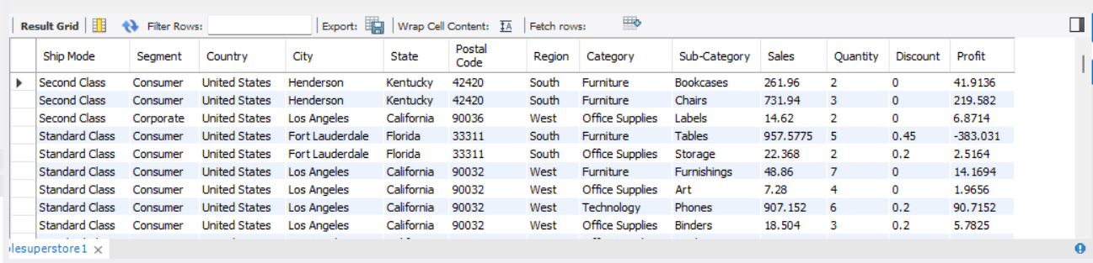
01 :- Display all columns from the dataset.
QUERY :
SELECT * FROM sample superstore;

Slide 3
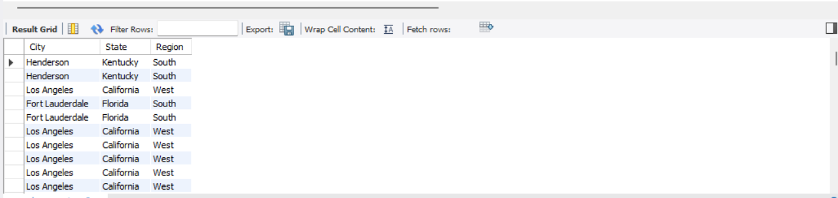
02 :- Display only the City, State, and Region columns.
QUERY :
SELECT City, State, Region FROM samplesuperstore;

Slide 4
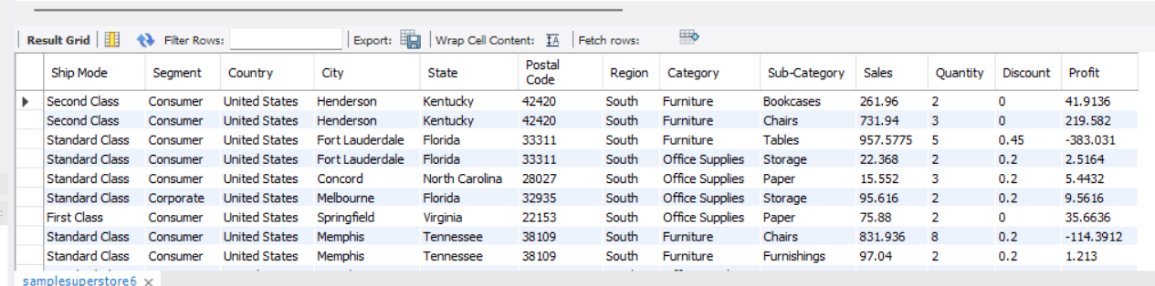
03 :- Show all records where the Region is “South”.
QUERY :
SELECT * FROM samplesuperstore WHERE Region = 'South';

Slide 5
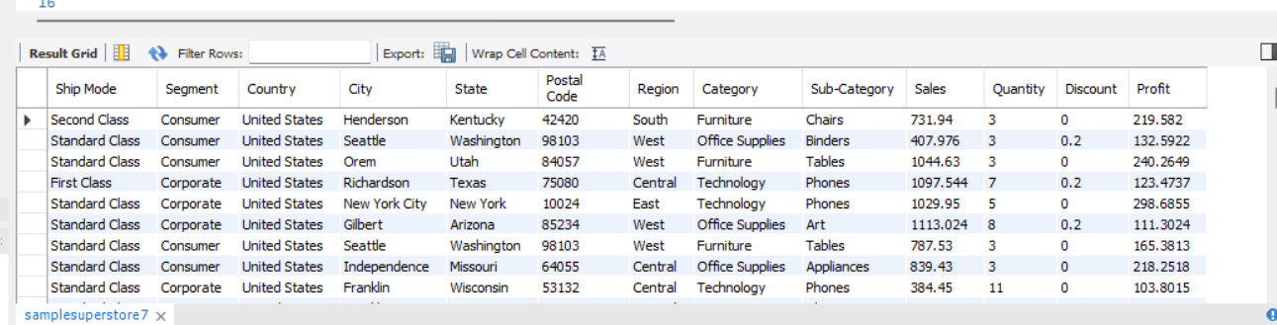
04 :- Show all records where Profit is greater than 100.
QUERY :
SELECT * FROM samplesuperstore WHERE Profit > 100;

Slide 6
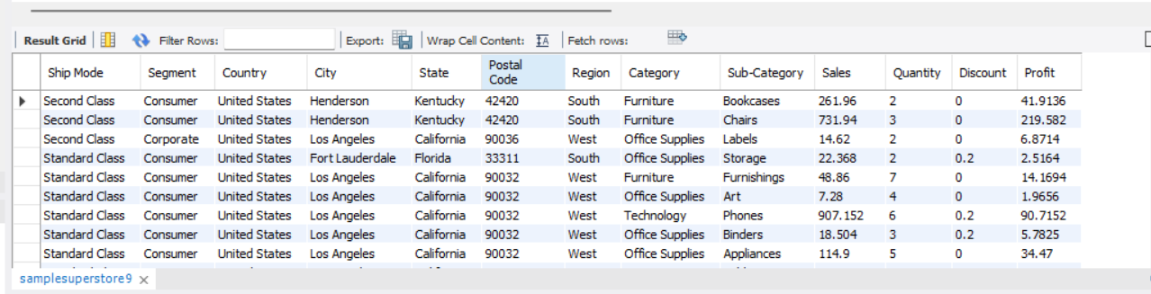
05 :- Display all orders with Discount greater than 0.3.
QUERY :
SELECT * FROM samplesuperstore WHERE Discount < 0.3;

Slide 7
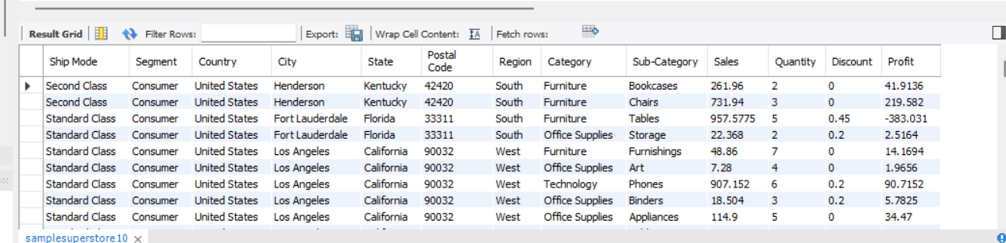
06 :- Display all orders from the Consumer segment.
QUERY :
SELECT * FROM samplesuperstore WHERE Segment = 'Consumer';

Slide 8
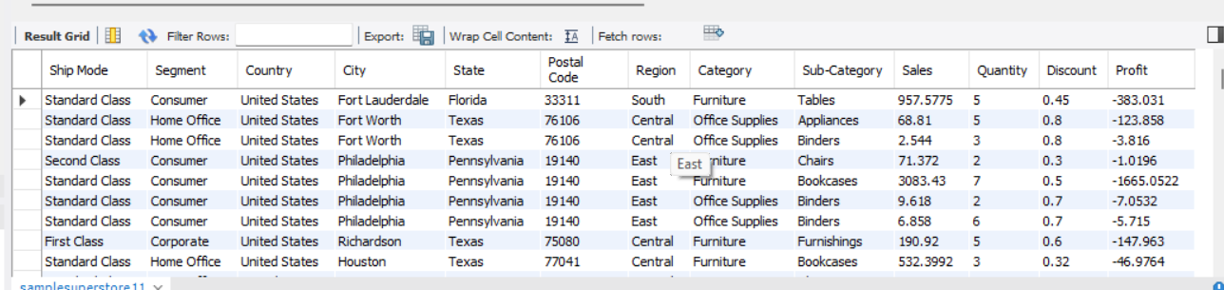
07 :- Find all orders that resulted in a loss (Profit < 0).
QUERY :
SELECT * FROM samplesuperstore WHERE Profit < 0;

Slide 9
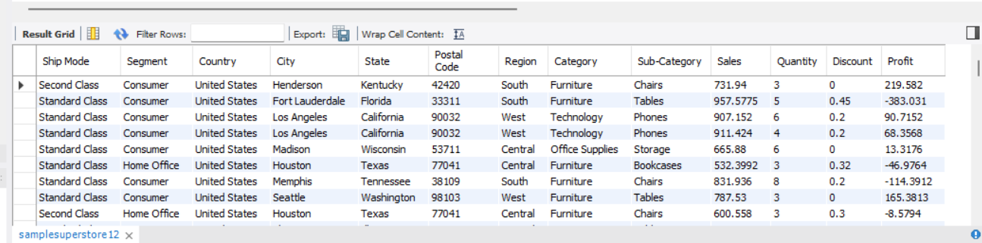
08 :- Display all orders with Sales between 500 and 1000.
QUERY :
SELECT * FROM samplesuperstore WHERE Sales BETWEEN 500 AND 1000;

Slide 10
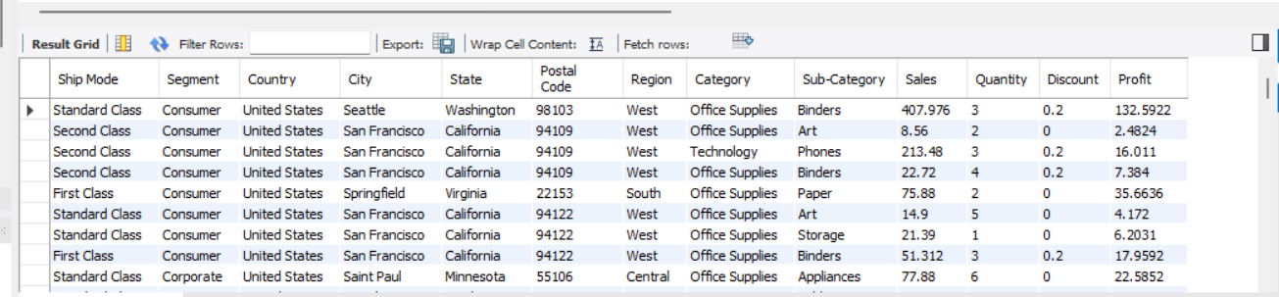
09 :- Show all orders where City starts with “S”.
QUERY :
SELECT * FROM samplesuperstore WHERE City LIKE 'S%';

Slide 11
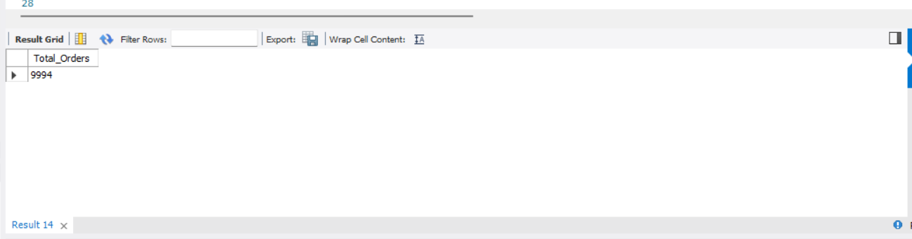
10 :- Display total number of orders.
QUERY :
SELECT COUNT(*) AS Total_Orders FROM samplesuperstore;

Slide 12
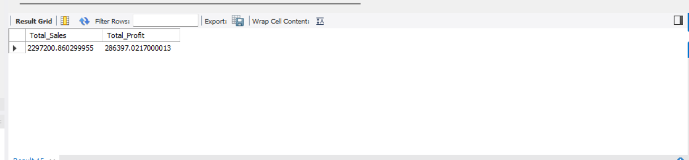
11 :- Calculate total sales and profit.
QUERY :
SELECT SUM(Sales) AS Total_Sales, SUM(Profit) AS Total_Profit FROM samplesuperstore;

Slide 13
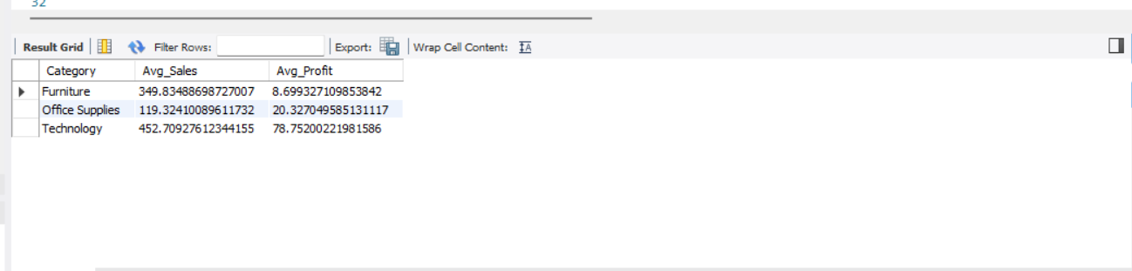
12 :- Show average sales and profit per Category.
QUERY :
SELECT Category, AVG(Sales) AS Avg_Sales, AVG(Profit) AS Avg_Profit FROM samplesuperstore GROUP BY Category;

Slide 14
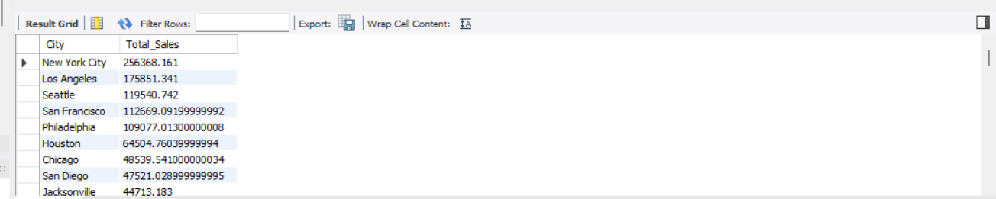
13 :- Show top 5 cities by total sales.
QUERY :
SELECT City, SUM(Sales) AS Total_Sales FROM samplesuperstore GROUP BY City ORDER BY Total_Sales DESC;

Slide 15
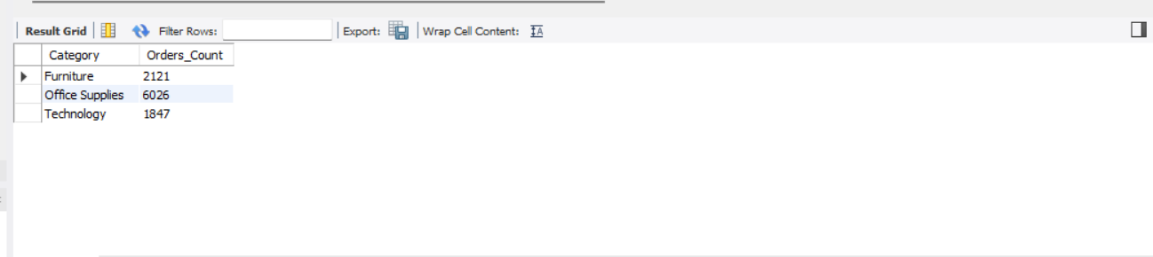
14 :- Find total number of orders for each category.
QUERY :
SELECT Category, COUNT(*) AS Orders_Count FROM samplesuperstore GROUP BY Category;

Slide 16
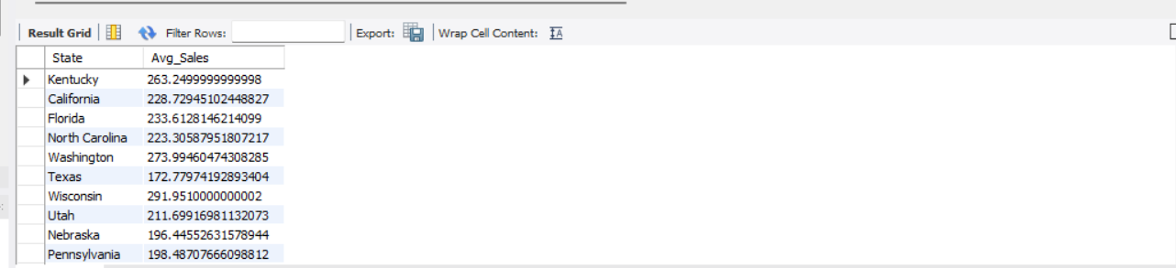
15 :- Find average sales per order in each State.
QUERY :
SELECT State, AVG(Sales) AS Avg_Sales FROM samplesuperstore GROUP BY State;

Slide 17
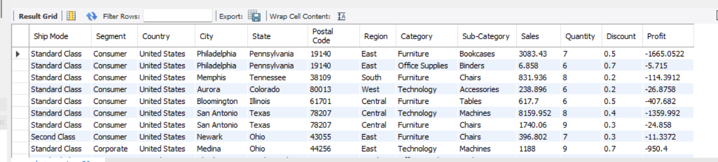
16 :- Show orders with quantity greater than 5 and profit less than 0.
QUERY :
SELECT * FROM samplesuperstore WHERE Quantity > 5 AND Profit < 0;

Slide 18
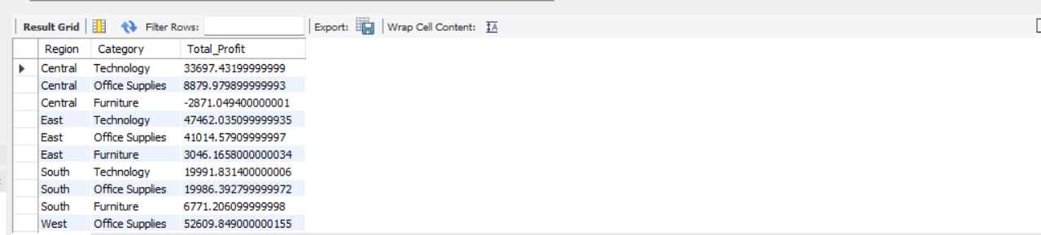
17 :- Find top 3 profitable categories per region (using subquery).
QUERY :
SELECT Region, Category, SUM(Profit) AS Total_Profit
FROM samplesuperstore
GROUP BY Region, Category
ORDER BY Region, Total_Profit DESC;

Slide 19
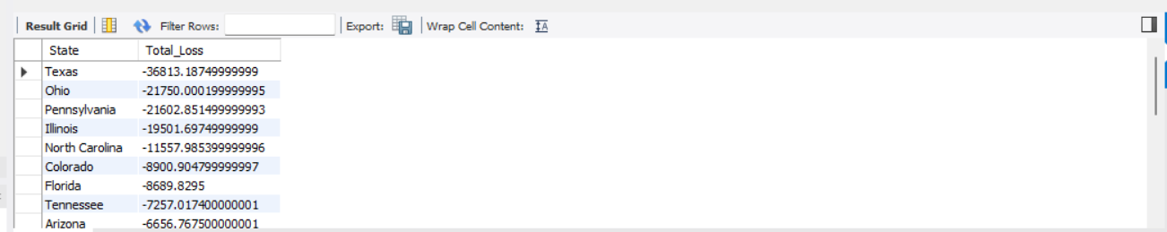
18 :- Find the state that generated the most loss (negative profit).
QUERY :
SELECT State, SUM(Profit) AS Total_Loss FROM samplesuperstore WHERE Profit < 0 GROUP BY State ORDER BY Total_Loss ASC ;

Slide 20
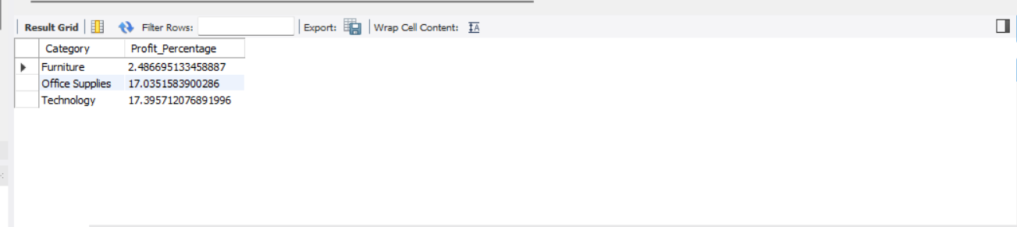
19 :- Find total profit percentage (Profit/Sales * 100) for each category.
QUERY :
SELECT Category, (SUM(Profit)/SUM(Sales))*100 AS Profit_Percentage FROM samplesuperstore GROUP BY Category;

Slide 21
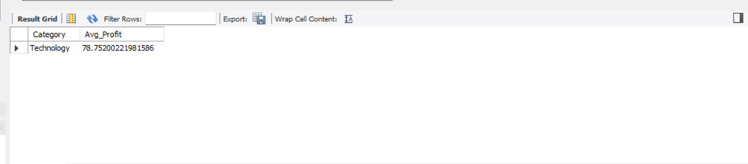
20 :- Find average profit per Category and list only those above overall average.
QUERY :
SELECT Category, AVG(Profit) AS Avg_Profit
FROM samplesuperstore
GROUP BY Category
HAVING AVG(Profit) > (SELECT AVG(Profit) FROM samplesuperstore);

Slide 22
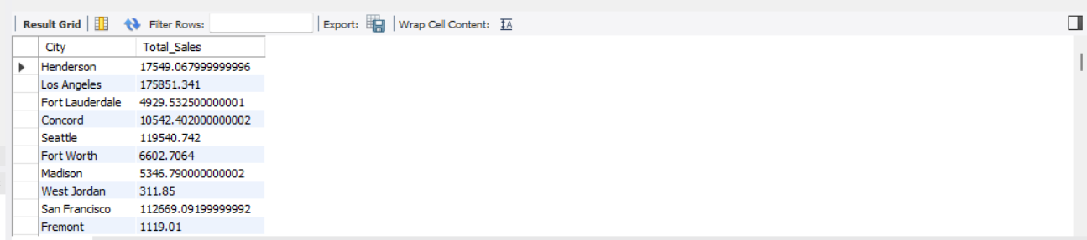
21 :- Find cities having total sales greater than average of all city sales.
QUERY :
SELECT City, SUM(Sales) AS Total_Sales
FROM samplesuperstore
GROUP BY City
HAVING SUM(Sales) > (SELECT AVG(Sales) FROM samplesuperstore);

Slide 23
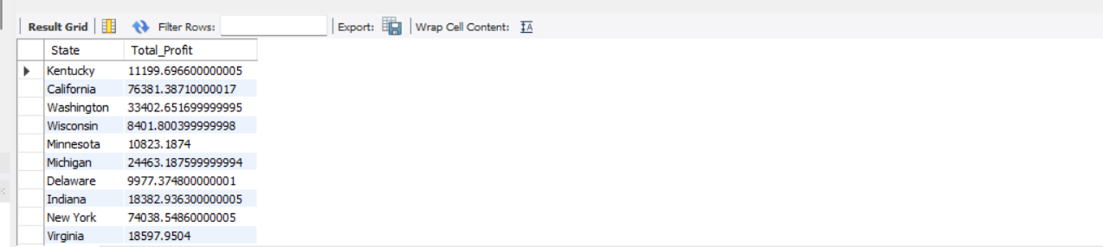
22 :- Find all states having total profit greater than 5000.
QUERY :
SELECT State, SUM(Profit) AS Total_Profit FROM samplesuperstore GROUP BY State HAVING Total_Profit > 5000;

Slide 24
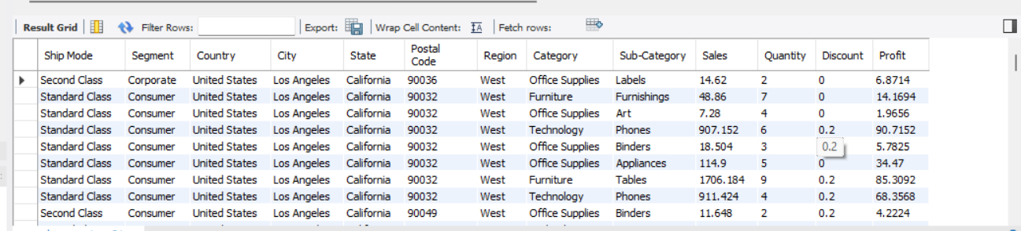
23 :- Show all records where city is “Los Angeles” or “New York City”.
QUERY :
SELECT * FROM samplesuperstore WHERE City IN ('Los Angeles', 'New York City');

Slide 25
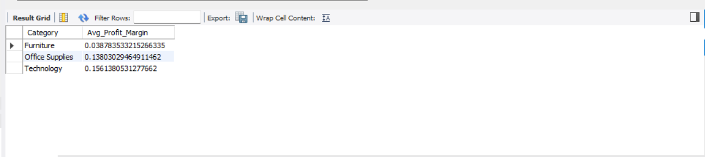
24 :- Find average profit margin (Profit/Sales) by Category.
QUERY :
SELECT Category, AVG(Profit/Sales) AS Avg_Profit_Margin FROM samplesuperstore GROUP BY Category;

Slide 26
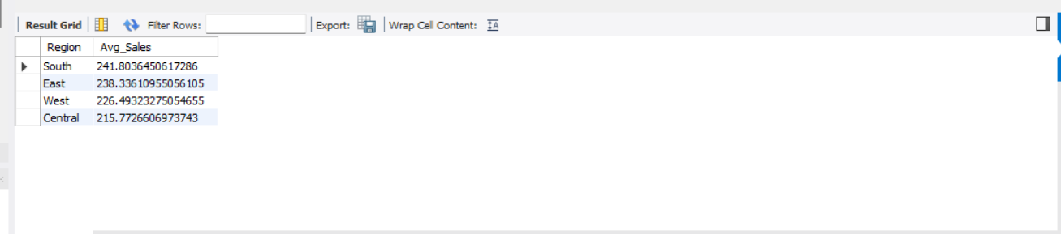
25 :- Find the region with the highest average sales per order.
QUERY :
SELECT Region, AVG(Sales) AS Avg_Sales FROM samplesuperstore GROUP BY Region ORDER BY Avg_Sales DESC ;

